Slide 1

TrumpTweets.Project3
Prepared By:
Edward Doris
Hailu Sefera
Taiwo Onitiri

Slide 2
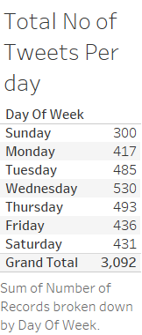

Slide 3
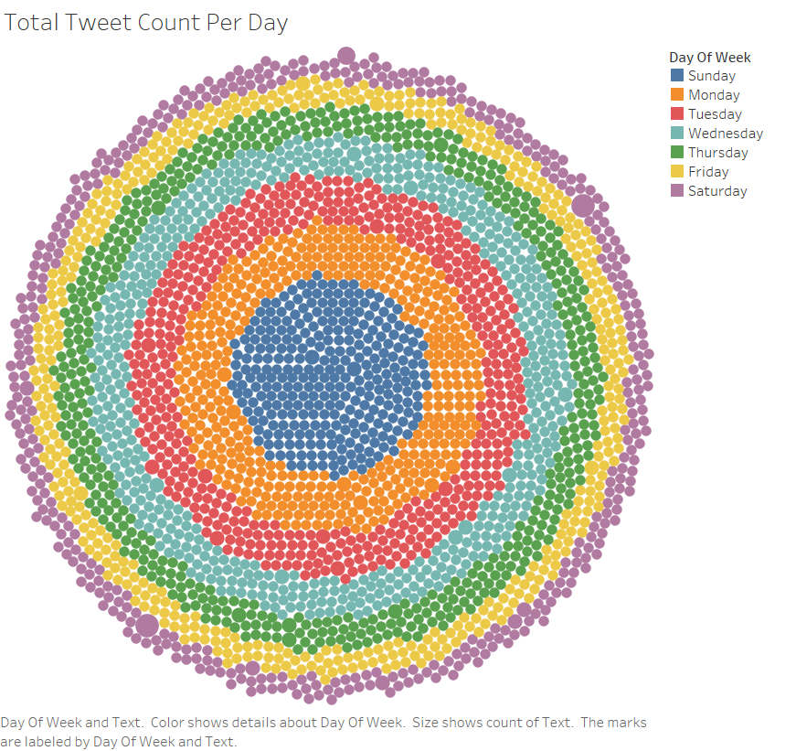

Slide 4
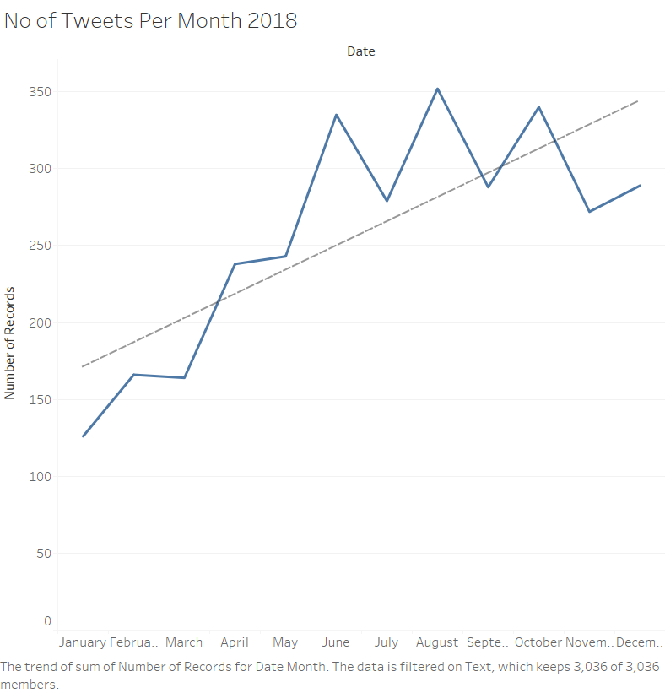
Notes:
Trend Lines Model
A linear trend model is computed for sum of Number of Records given Date Month. The model may be significant at p <= 0.05.
Model formula:
( Month of Date + intercept )
Number of modeled observations:
12
Number of filtered observations:
0
Model degrees of freedom:
2
Residual degrees of freedom (DF):
10
SSE (sum squared error):
23932.6
MSE (mean squared error):
2393.26
R-Squared:
0.596651
Standard error:
48.9209
p-value (significance):
0.0032328
Individual trend lines:
Panes
Line
Coefficients
Row
Column
p-value
DF
Term
Value
StdErr
t-value
p-value
Number of Records
Month of Date
0.0032328
10
Month of Date
15.7343
4.09097
3.84609
0.0032328
intercept
155.394
30.1087
5.16109
0.0004246

Slide 5
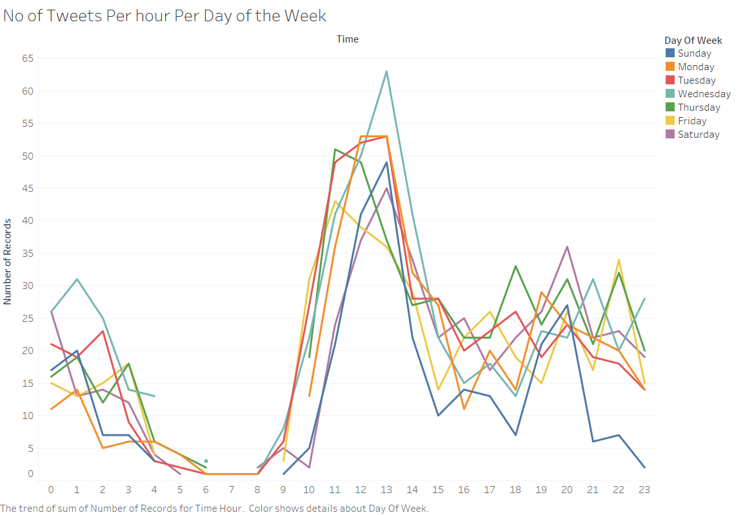

Slide 6
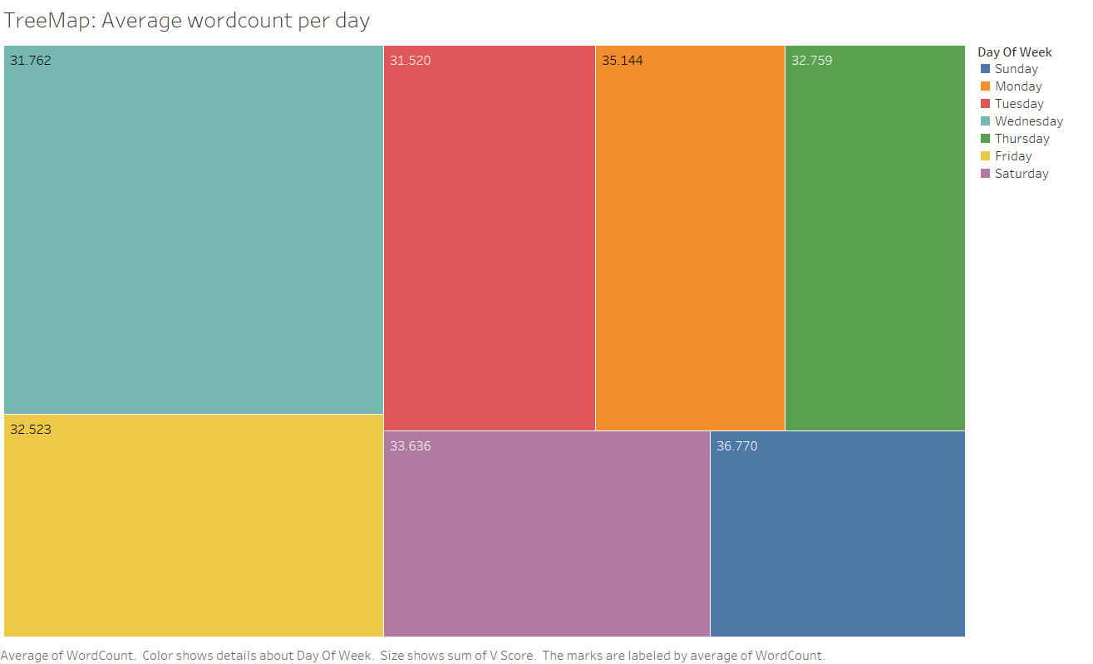

Slide 7
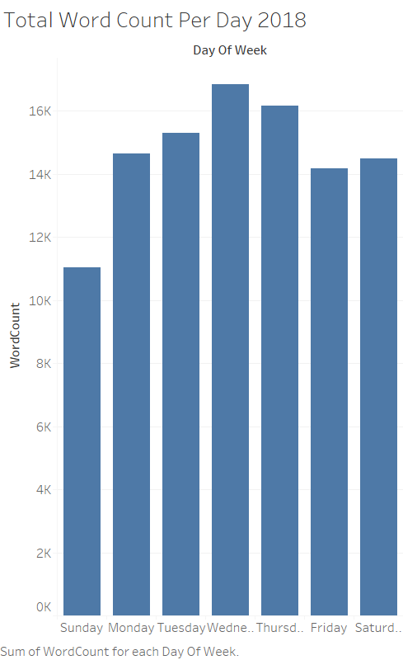

Slide 8
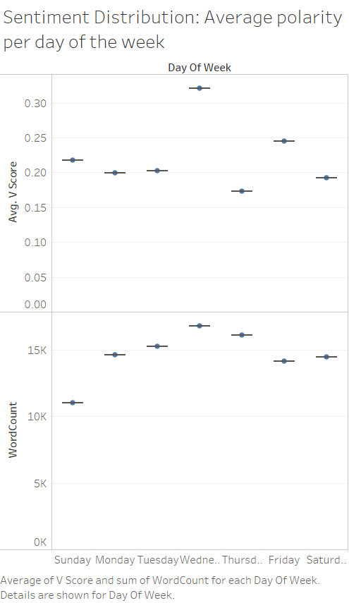

Slide 9
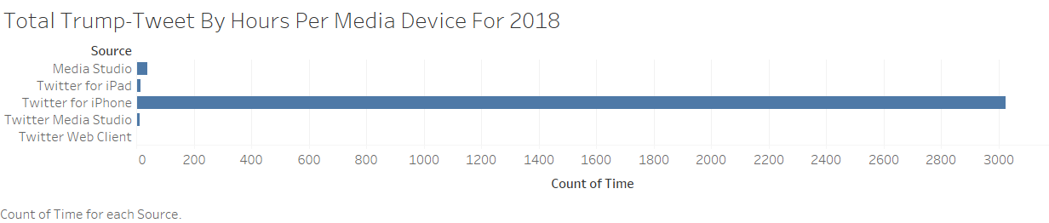

Slide 10
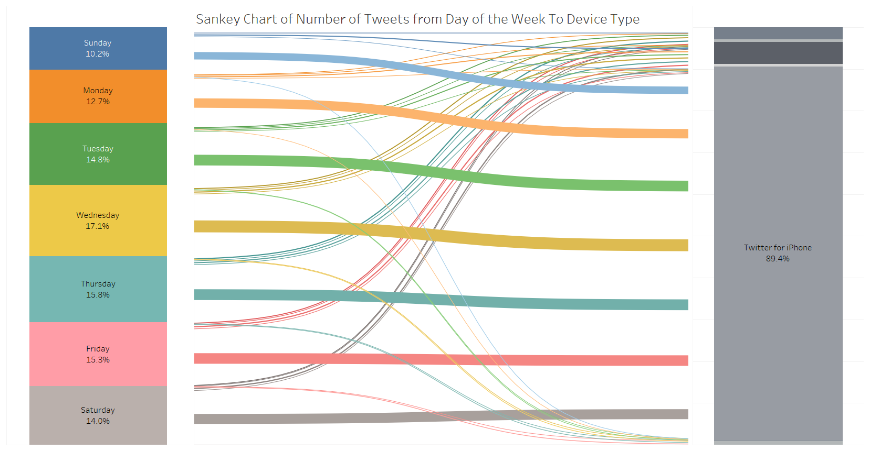

Slide 11
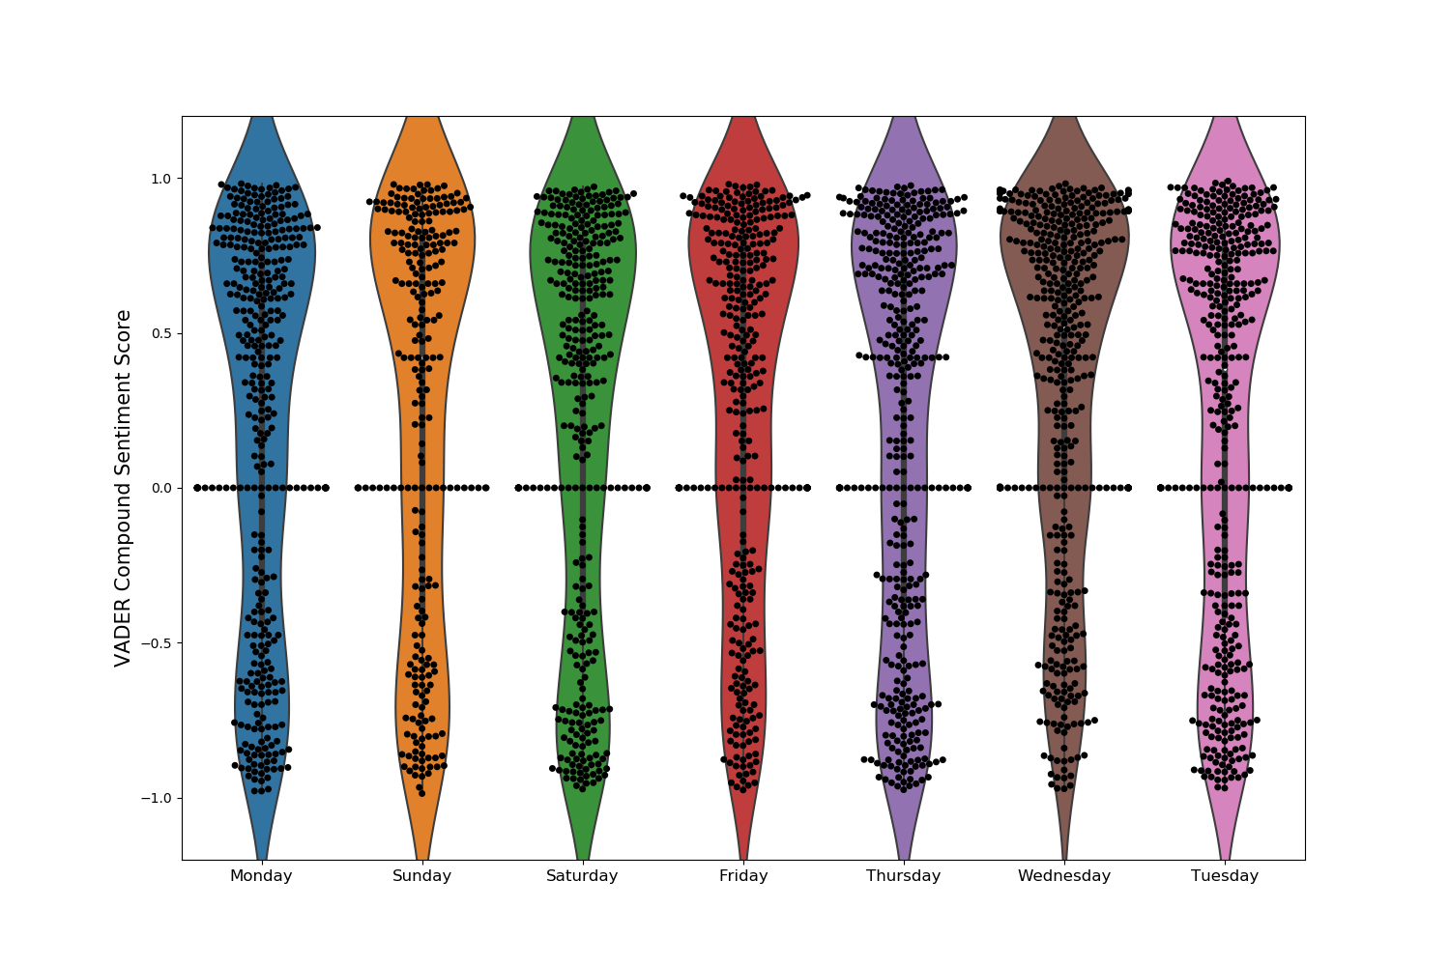
VADER Compound Sentiment Score ( Weekly 2017 - 2018)

Slide 12
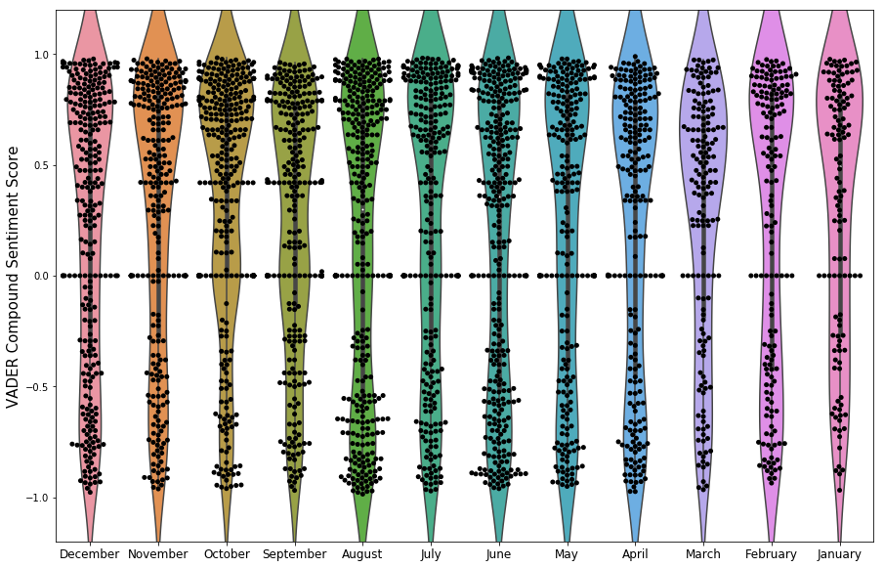
VADER Compound Sentiment Score ( Monthly 2017-18)

Slide 13

Word Cloud

Slide 14
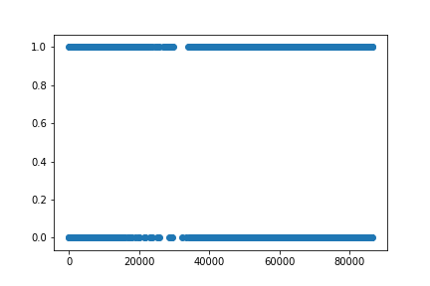
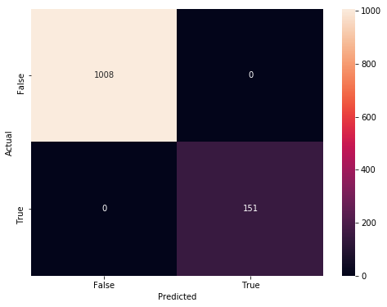
Lack of Dimensions to make models work.
Linear Regression Fail
Confusion Matrix Fail

Slide 15
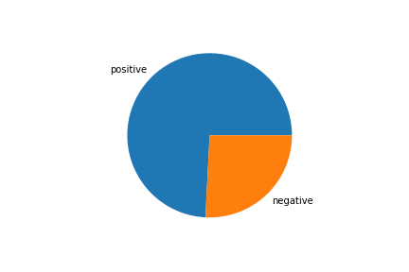
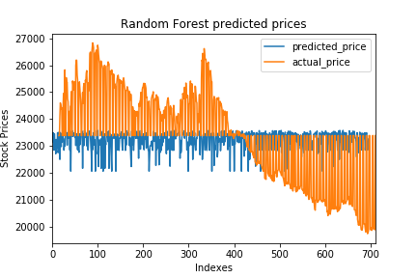
STOCK PREDICTION USING TRUMP TWITTER SENTIMENT ANALYSIS (2017-18)
Pie chart showing positive and negative tweets
Predicted DOW Price Vs Actual Price
Notes:
Options Used to Create Forecasts
Time series:Month of DateMeasures:Avg. Prices, Sum of Number of RecordsForecast forward:11 months (December 2018 – October 2019)Forecast based on:January 2017 – November 2018Ignore last:1 month (December 2018)Seasonal pattern:None (Not enough data to search for a seasonal pattern recurring every 12 Months)
Avg. Prices
InitialChange From InitialSeasonal EffectContributionDecember 2018December 2018 – October 2019HighLowTrendSeasonQuality25,168±8051,650None100.0%0.0%Poor Sum of Number of Records
InitialChange From InitialSeasonal EffectContributionDecember 2018December 2018 – October 2019HighLowTrendSeasonQuality29±40None0.0%0.0%Ok
All forecasts were computed using exponential smoothing. Avg. Prices
ModelQuality MetricsSmoothing CoefficientsLevelTrendSeasonRMSEMAEMASEMAPEAICAlphaBetaGammaAdditiveAdditiveNone4113131.031.3%2870.5000.0000.000 Sum of Number of Records
ModelQuality MetricsSmoothing CoefficientsLevelTrendSeasonRMSEMAEMASEMAPEAICAlphaBetaGammaAdditiveNoneNone210.704.9%350.0400.0000.000

Slide 16
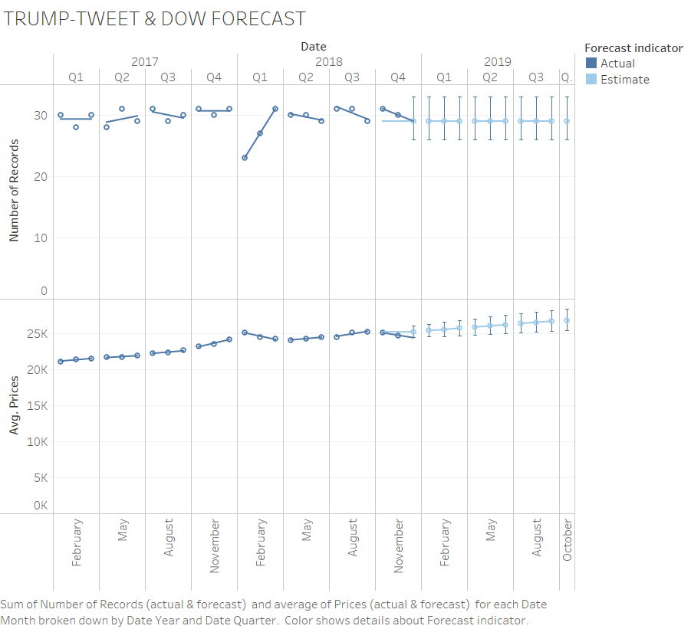
Notes:
Trend Lines Model
A linear trend model is computed for average of Prices (actual & forecast) given Date Month. The model may be significant at p <= 0.05. The factor Forecast indicator may be significant at p <= 0.05. The factor Quarter of Date may be significant at p <= 0.05. The factor Year of Date may be significant at p <= 0.05.
Model formula:
Forecast indicator*Quarter of Date*Year of Date*( Month of Date + intercept )
Number of modeled observations:
34
Number of filtered observations:
0
Model degrees of freedom:
24
Residual degrees of freedom (DF):
10
SSE (sum squared error):
120327
MSE (mean squared error):
12032.7
R-Squared:
0.998769
Standard error:
109.694
p-value (significance):
< 0.0001
Analysis of Variance:
Field
DF
SSE
MSE
F
p-value
Forecast indicator
1
109931.74
109932
9.13605
0.0128386
Quarter of Date
17
1974476.4
116146
9.65247
0.0004404
Year of Date
8
38104083
4.76301e+06
395.837
< 0.0001
A linear trend model is computed for sum of Number of Records (actual & forecast) given Date Month. The model may be significant at p <= 0.05. The factor Year of Date may be significant at p <= 0.05.
Model formula:
Forecast indicator*Quarter of Date*Year of Date*( Month of Date + intercept )
Number of modeled observations:
34
Number of filtered observations:
0
Model degrees of freedom:
24
Residual degrees of freedom (DF):
10
SSE (sum squared error):
9.83333
MSE (mean squared error):
0.983333
R-Squared:
0.870664
Standard error:
0.991632
p-value (significance):
0.040611
Analysis of Variance:
Field
DF
SSE
MSE
F
p-value
Forecast indicator
1
-1.7763568e-15
-1.776e-15
-1.806e-15
N/A
Quarter of Date
17
37.985781
2.23446
2.27233
0.094151
Year of Date
8
26.22619
3.27827
3.33384
0.0392629

Slide 17

Observation
We were able to show correlation between number of tweets and sentiment.
More tweets with larger word counts trended towards more positive sentiment in those tweets.
Activity on twitter trended towards increasing in the middle of the week and at the end of the year.
I-phone was the most preferred device.
Bag of words technique seemed to highlight more negative phrases being used.
Our model wasn't a good fit.

Slide 18
Conclusion
The general tone of the tweets was positive. Further analysis of the content of the negative and positive tweets would have benefitted the project.
Further exploration into the content of the tweets would ensure the Vader scores are in alignment with the word frequency identified in the word cloud.
Our analysis of the tweets didn't identify sentiment exclusive to markets and the economy and may not correlate to the performance of the DJA.
Chiefs will win the Superbowl.

Slide 19

THANK YOU !
This Photo by Unknown Author is licensed under CC BY-SA

